Slide 1
Cyber Escape Room
Colby, Noah, Matt, Caroline, and Sam

Slide 2
Introduction
Client: Dr. Ibrahim
Issue: Needed a way to educate high school to college-aged students on cyber security issues.
Our Solution: A portable escape room that is cyber security themed. Blah blah blah

Slide 3
Technologies Used
HTML, CSS
Visual Studio Code
Github
YouTube to host videos
Adobe Premiere Pro, InDesign, Illustrator, Photoshop
Silhouette Studio

Slide 4
Tools Used
Open Lab 3D printer and Vinyl Cutter
Camera/Tripod

Slide 5
Challenges faced
Picking a topic.
Avoid marginalising a community/demographic.
No SUPER HEROES!
Attacker =/= Hacker
Oversaturation of red herrings.
We had to remove many fun easter eggs. (Journal)
Complying to regulations.
We couldn’t use thumb drives or QR codes.
Difficulty level adjustments.
We switched puzzle 4 to a Caesar cipher instead of a Vigenere cipher.

Slide 6
Significant Requirements Changes
Narrative
Trick - Originally, the players

Slide 7
What we feel system is good at (change this title)
Teaching students about cyber security.
Team building. Teaching students to collaborate.
Teaching problem-solving skills. Students develop critical thinking skills while working through the puzzles.
Teaching creative problem solving.

Slide 8
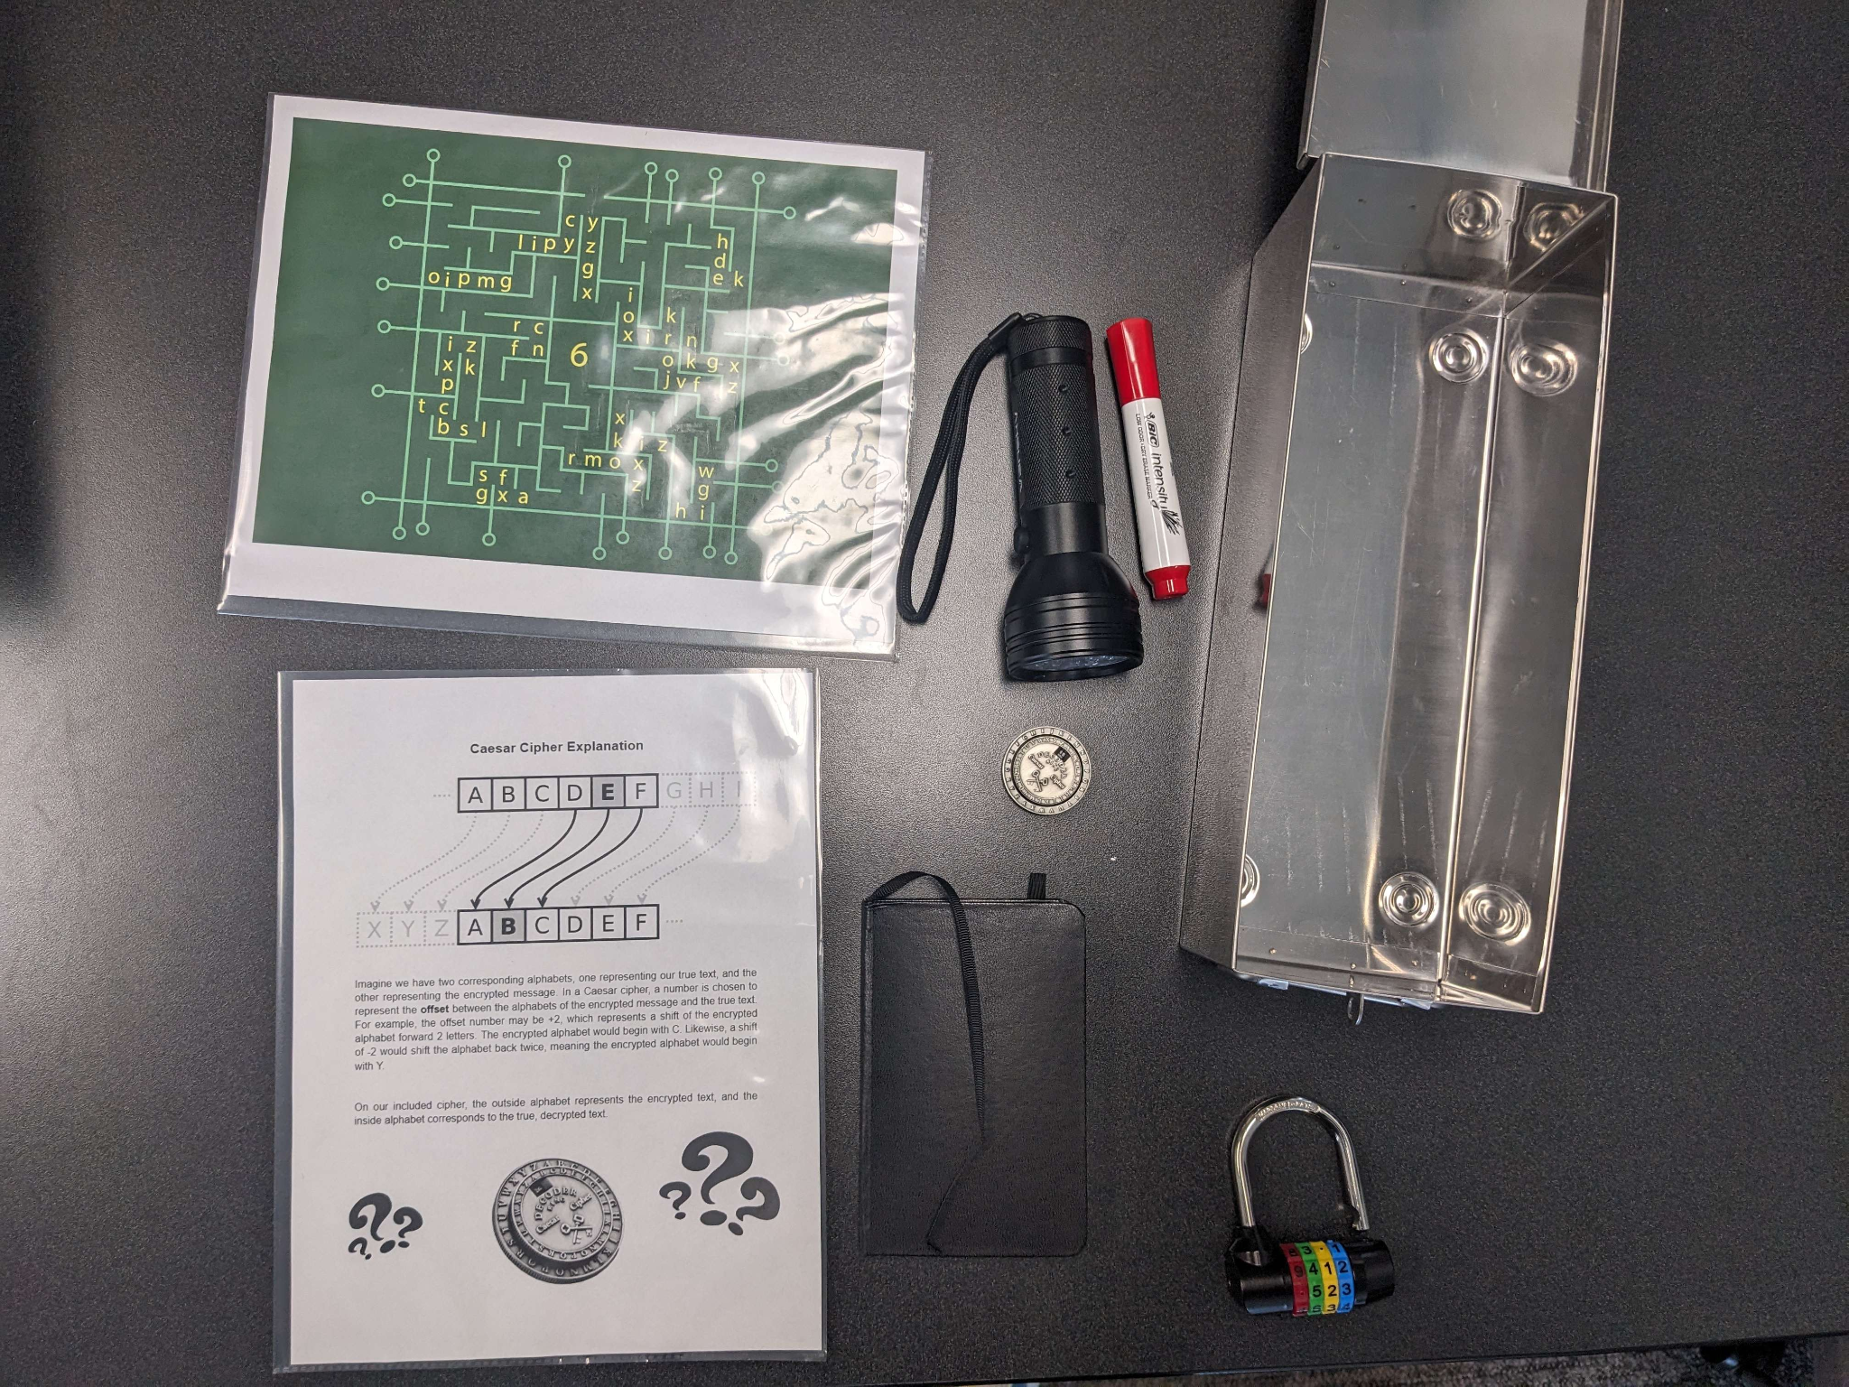
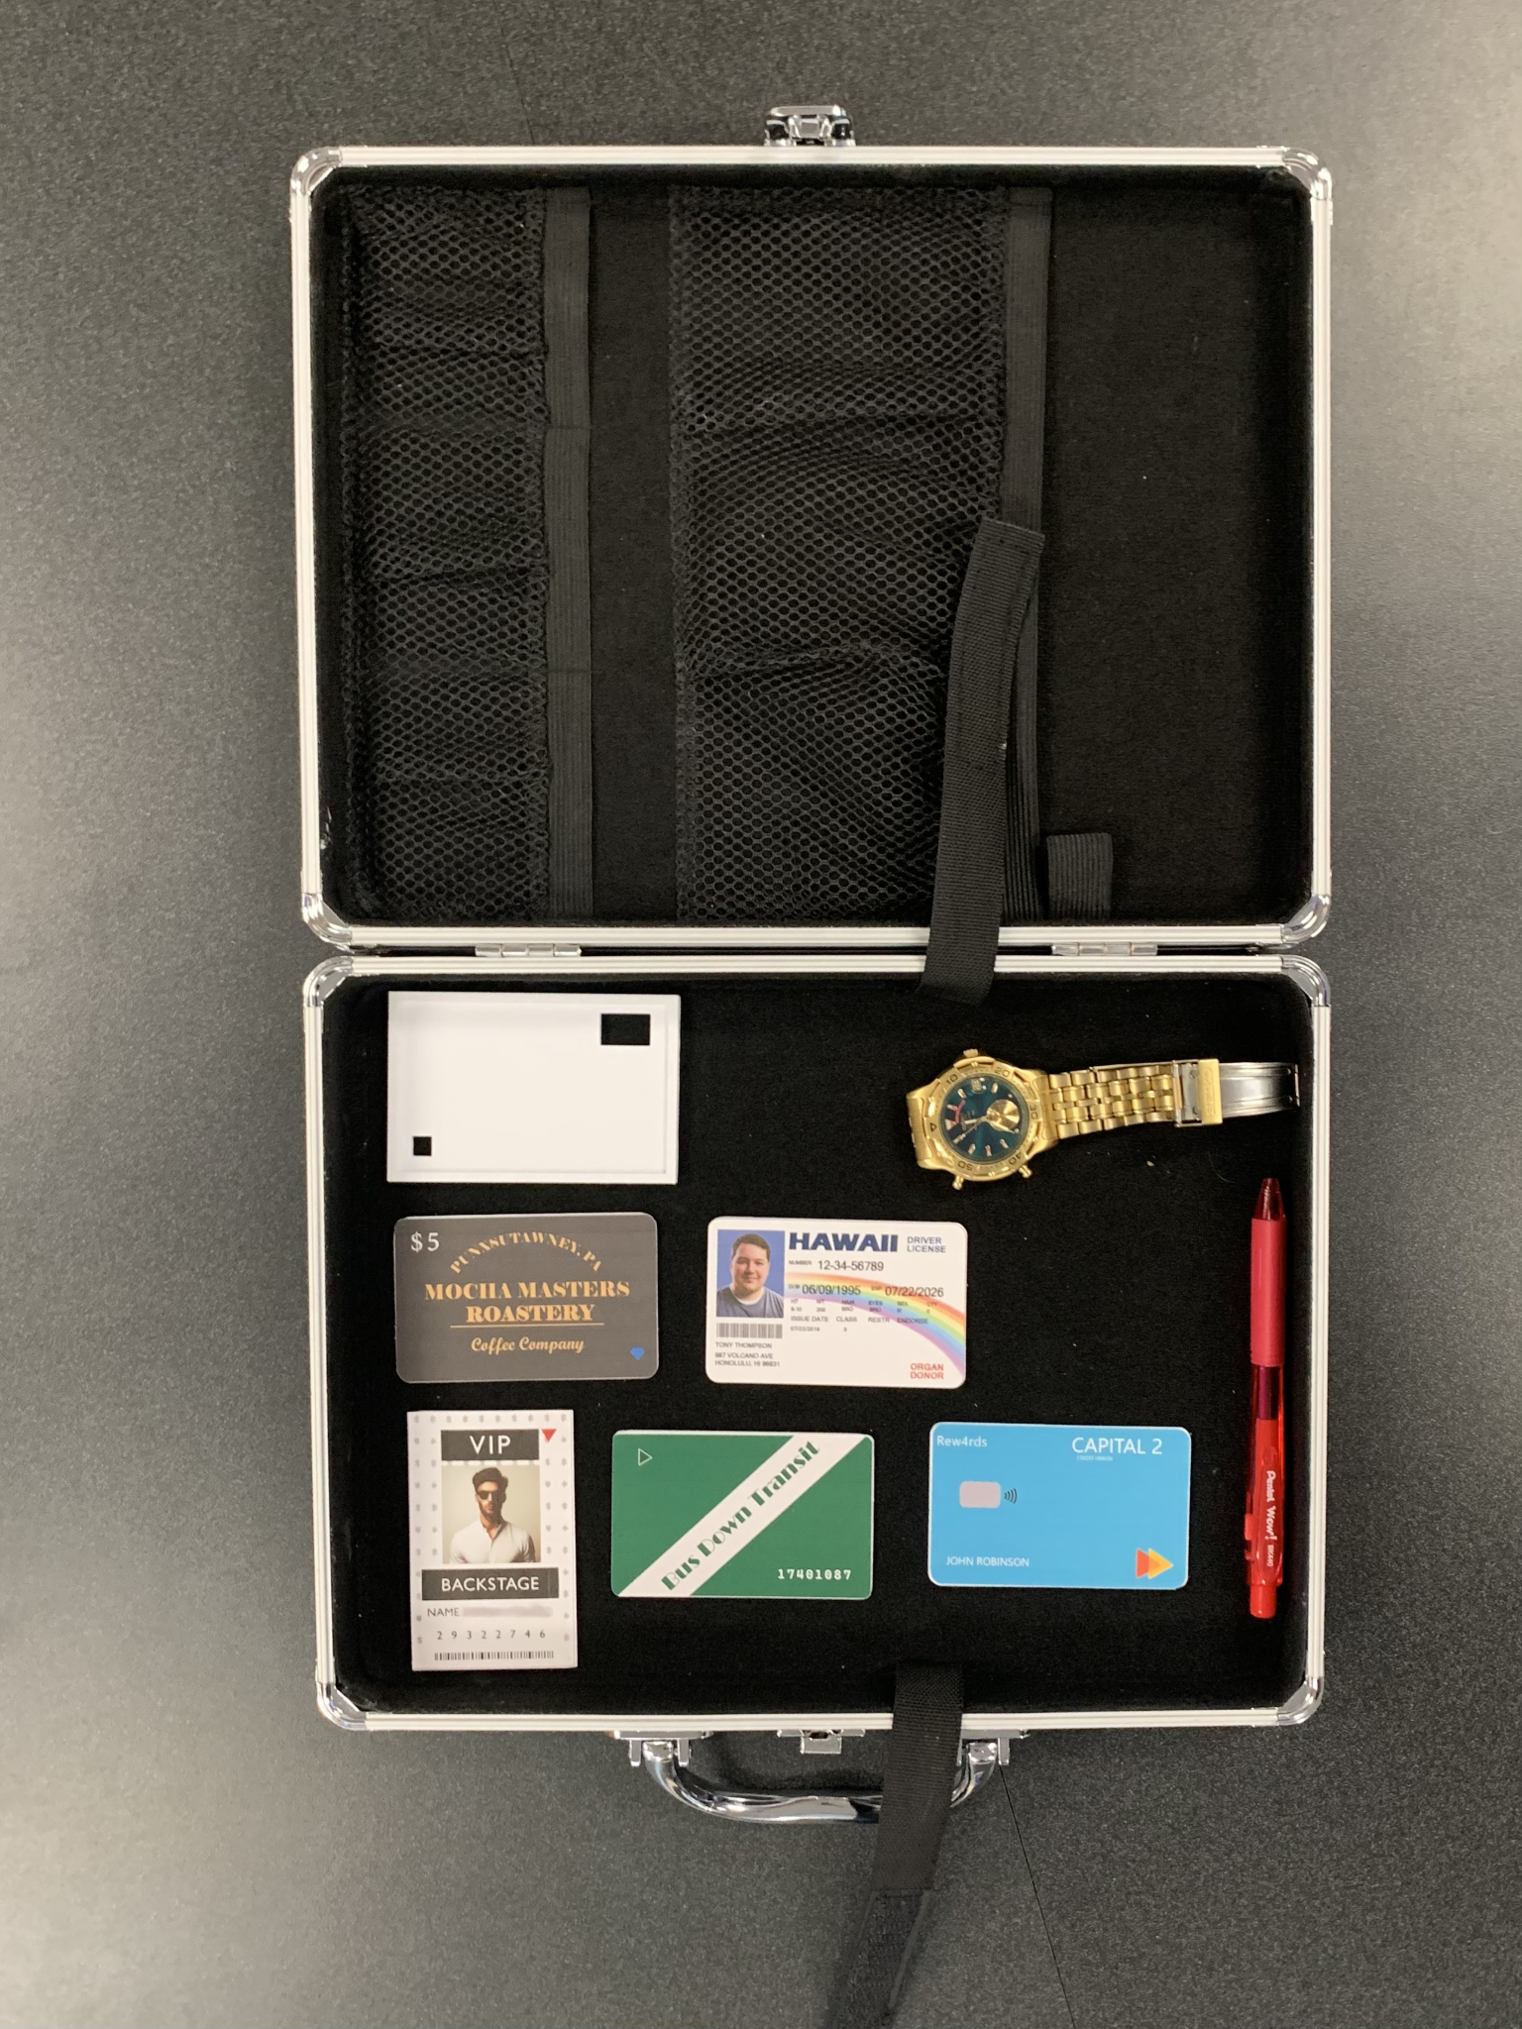
Puzzle Walk-Through

Slide 9
